Slide 1

Data Analysis In “Game of Thrones
Group 10
Yitong Liu
Leyi Wang
Yan Lyu
Xiao Liu
延时符

Slide 2

0
Objectives
Analyze the battles in “Game of Thornes”
1
Demonstrate the character relationship
2
Predict the death of a character
3
延时符

Slide 3
Progress
1
Data Preprocessing
2
Data Analysis
3
Building models
4
Conclusion
延时符

Slide 4
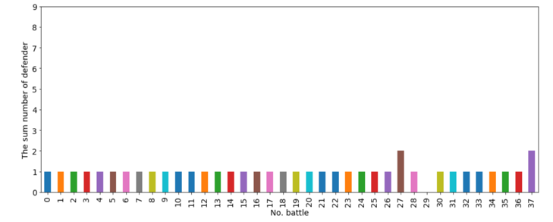
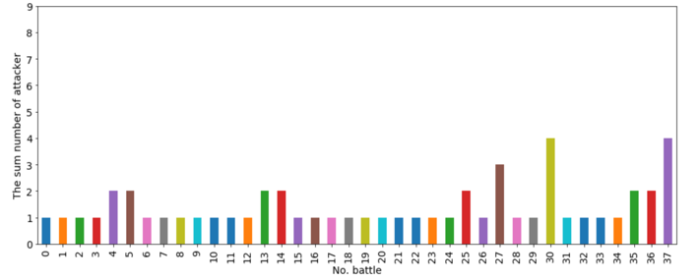
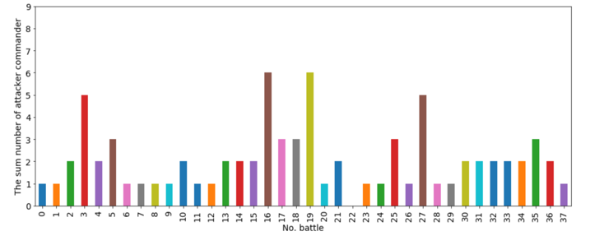
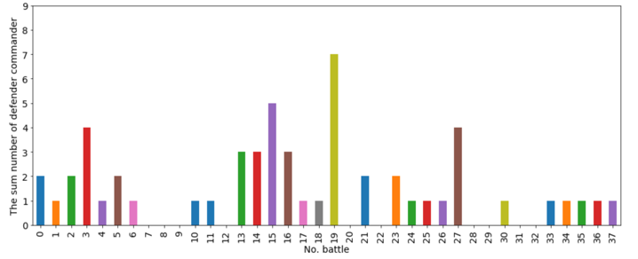
1
The analysis of battles
延时符

Slide 5
1
Key Words
1
Region and Death
2
Battles and Death
3
Culture and Death
4
Attacker King and Defender King
5
Greatest Commanders
延时符

Slide 6
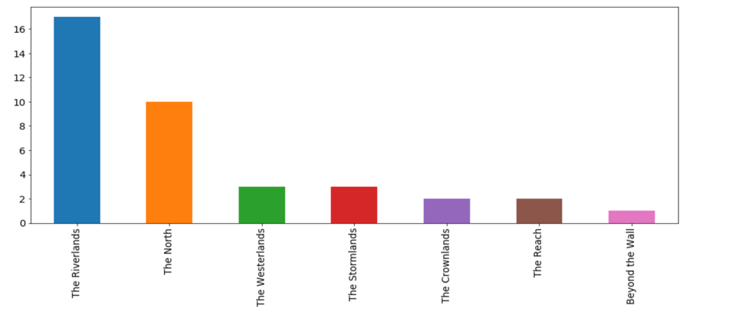
1
The analysis of battles
Death and region
延时符

Slide 7
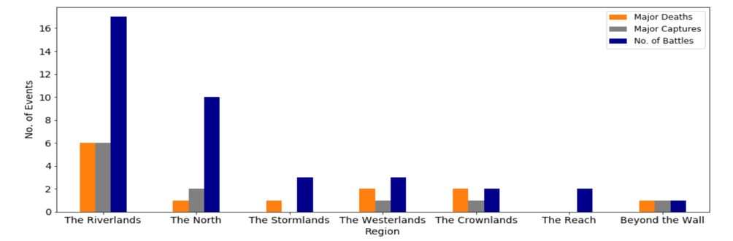
1
The analysis of battles
Battles and death
延时符

Slide 8
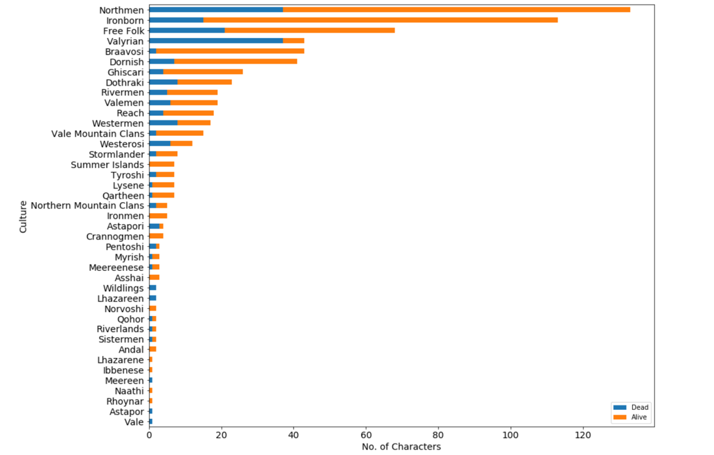
1
The analysis of battles
Culture and death
延时符

Slide 9
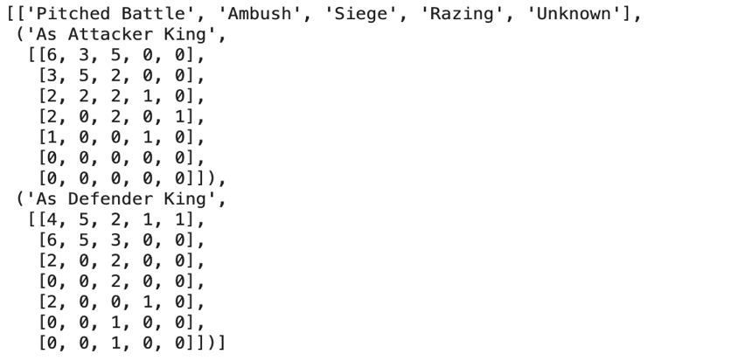
1
The analysis of battles
King and battles
Joffrey/Tommen Baratheon n Baratheon
Robb Stark Baratheon
Balon/ Euron Greyjoy
Stannis Baratheon
Unknown
Renly Baratheon
Mance Rayder
Joffrey/Tommen Baratheon n Baratheon
Robb Stark Baratheon
Balon/ Euron Greyjoy
Stannis Baratheon
Unknown
Renly Baratheon
Mance Rayder
延时符

Slide 10
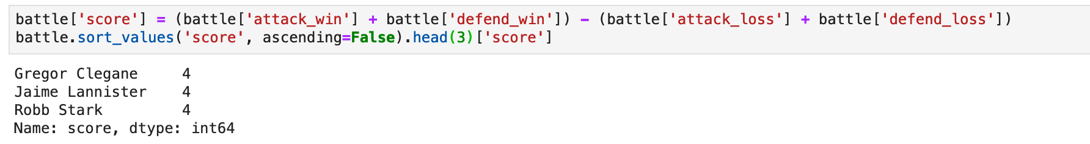
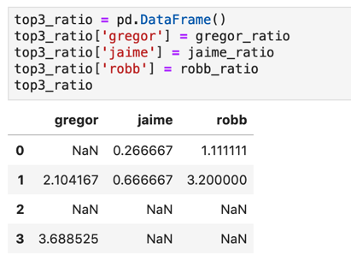
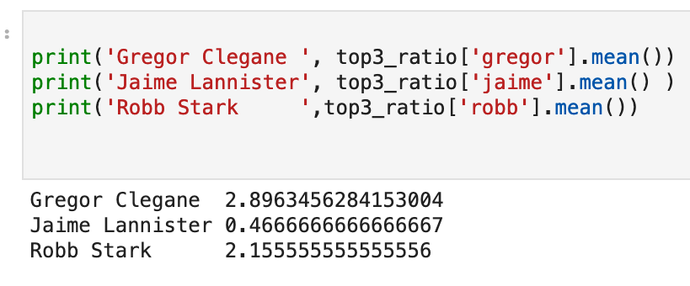
1
The analysis of battles
Greatest commanders in the battles
延时符

Slide 11
Demonstrate the character relationship
1
Data Preprocessing
2
Data Analysis
3
Building models
4
Conclusion
延时符

Slide 12
2
Analysis the importance of characters
Definition
Not shown frequency but ‘INTERACTION’
So, Generate a Graph
Data Set & Meaning
https://github.com/mathbeveridge/asoiaf
Node -- Character
Edge -- Interaction in 2 Characters
Weight – the frequency of ‘interaction’
延时符

Slide 13
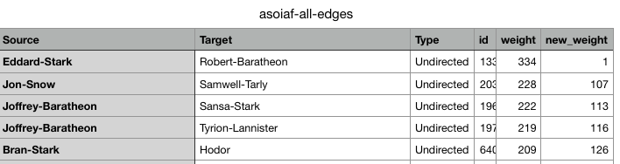
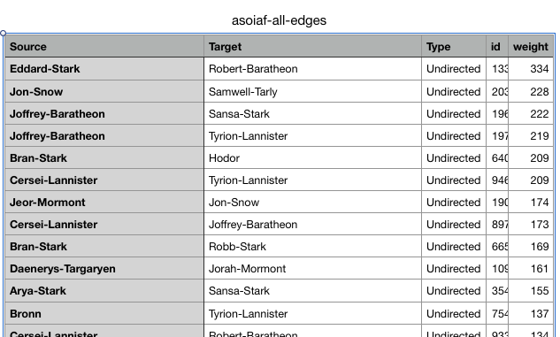
2
Data preprocessing
Why?
After
‘Weight’ descript how strong the interaction is.
So, It stands for the opposite of ‘distance’
Before
How?
FinalWeight = MaxOringinWeight + 1 – OriginWeight
延时符

Slide 14
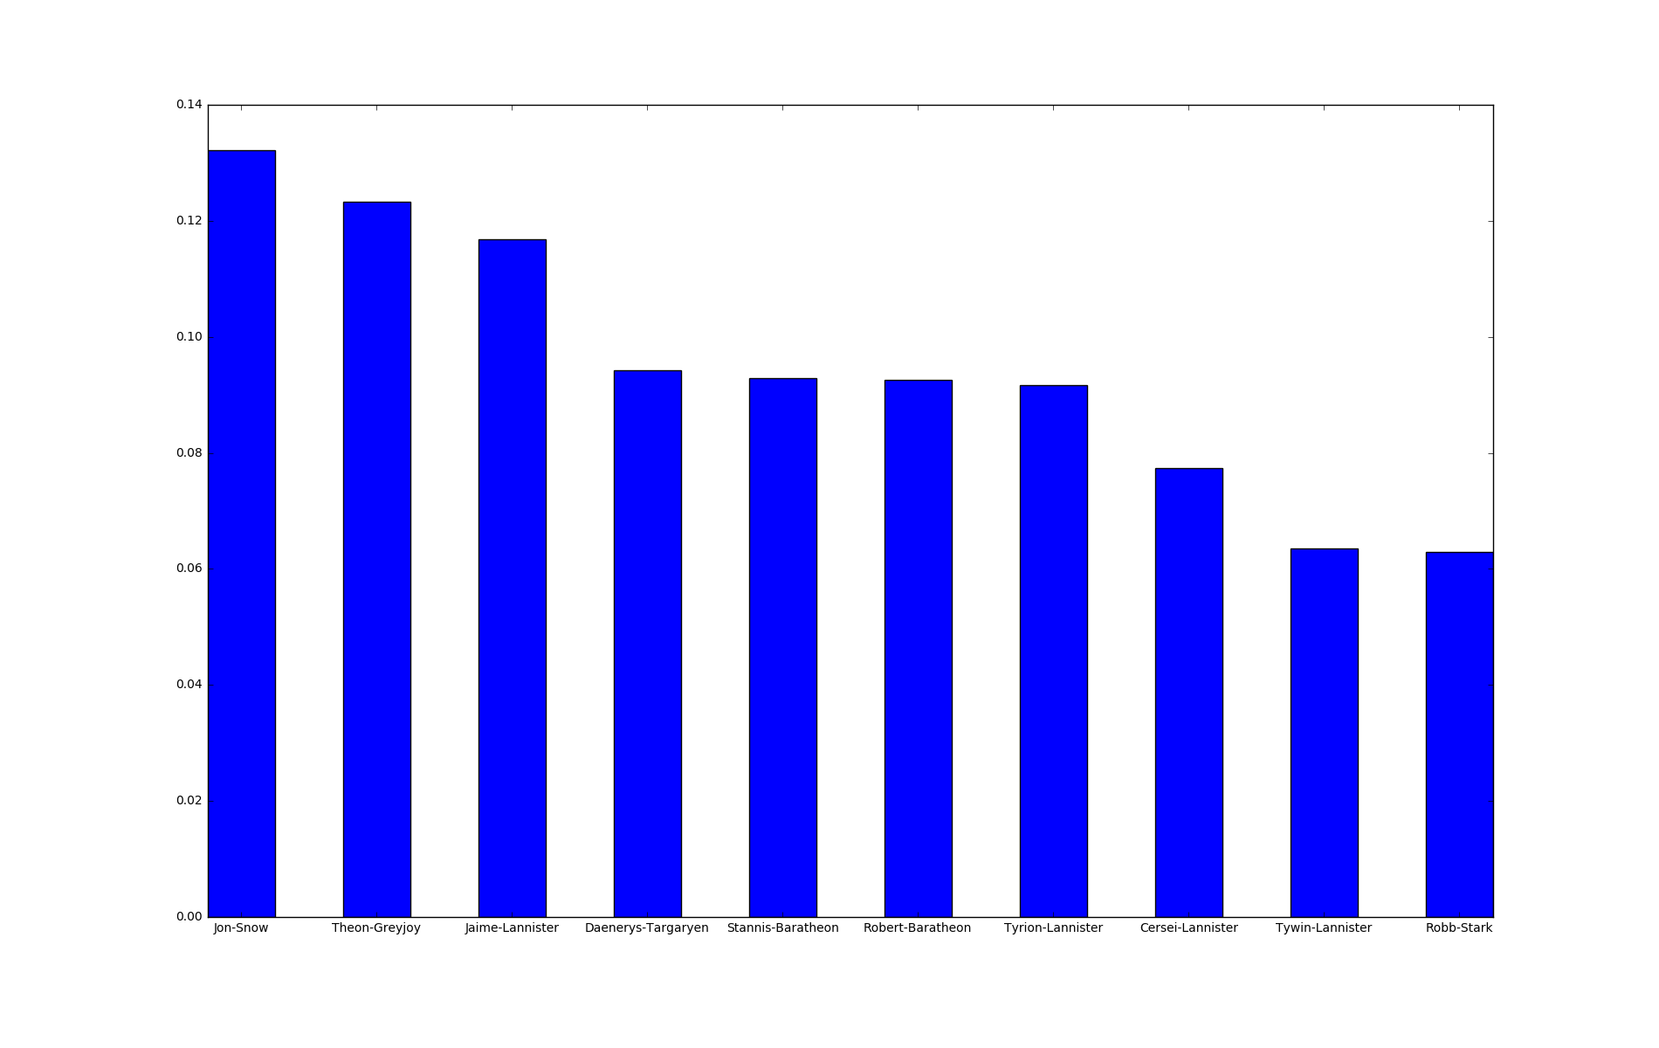
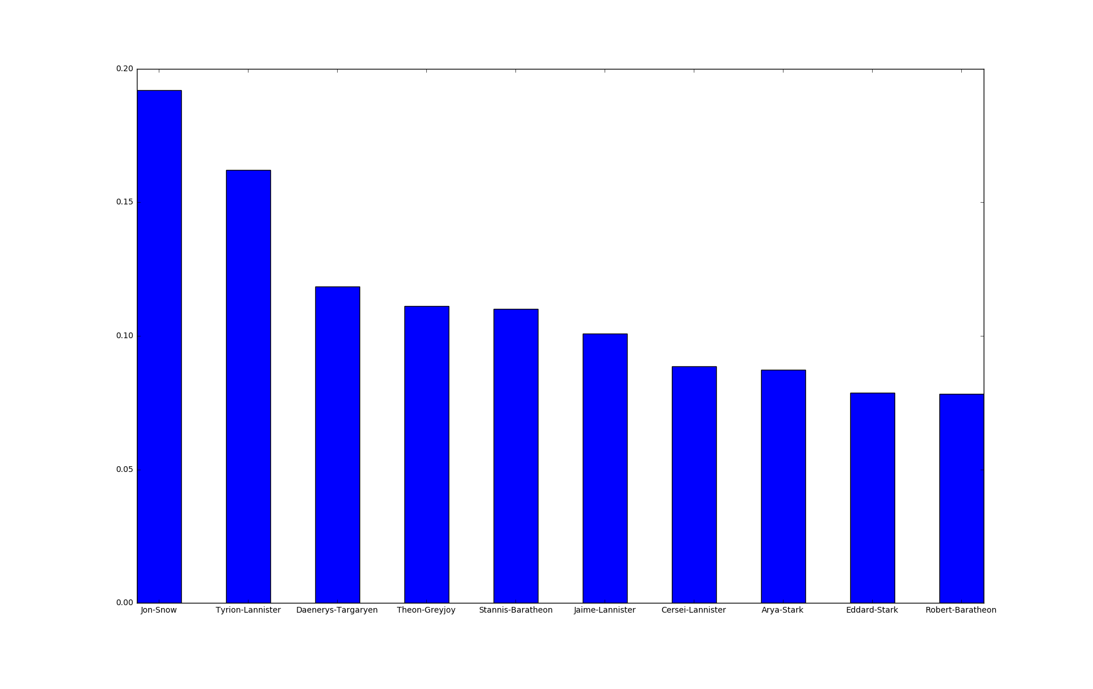
2
Performance Comparison
Before
After
延时符

Slide 15
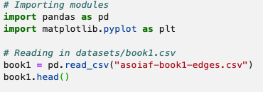
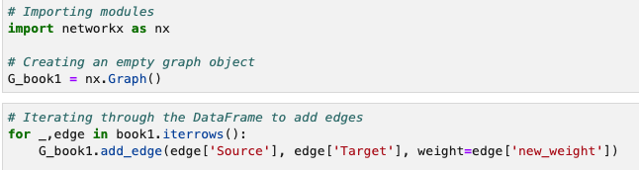
2
Steps for coding
Read the data
Generate a graph
延时符

Slide 16
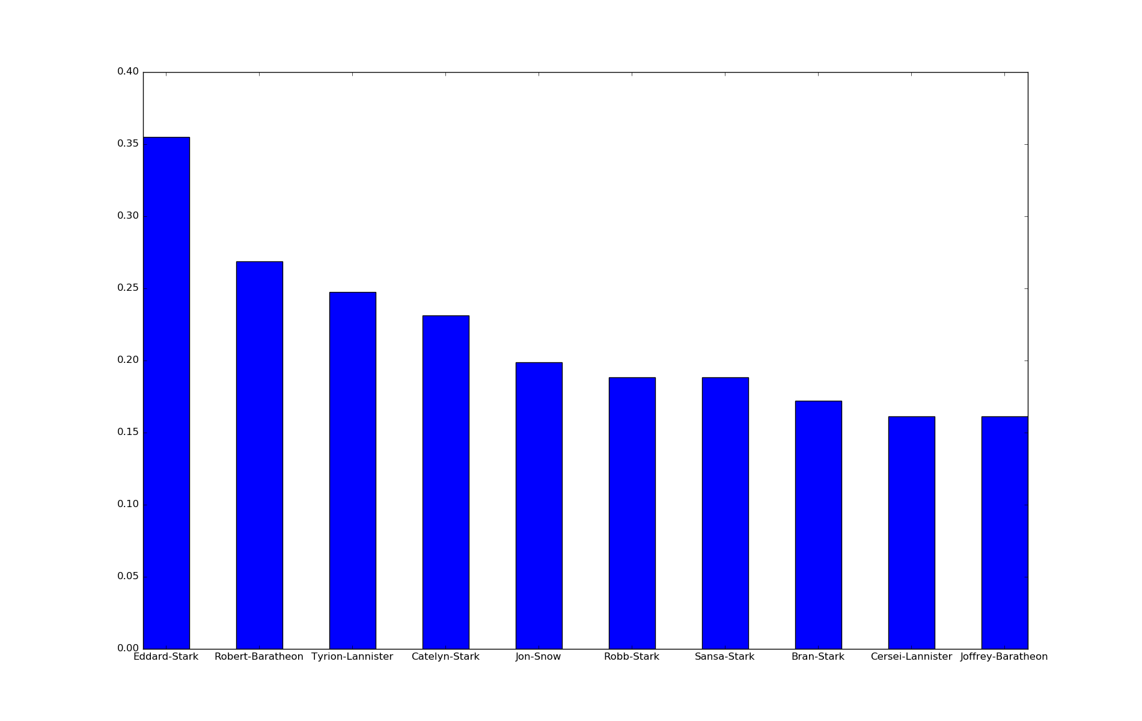
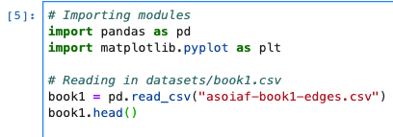
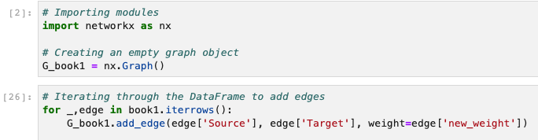
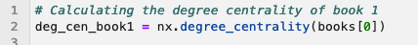
2
2
Calculate Degree Centrality
Data Analysis
1. Read Data
Degree Centrality
How many node connected to one node
Implement
2. Build Graph
Calculate
Sort top 10 high score
16
延时符

Slide 17
2
2
Calculate Betweenness Centrality
Data Analysis
1. Read Data
Betweenness Centrality
Measure the extent to which a node acts as a ‘bridge node’
For each pair of vertices (s,t), compute the shortest paths between them.
For each pair of vertices (s,t), determine the fraction of shortest paths that pass through the vertex in question (here, vertex v).
Sum this fraction over all pairs of vertices (s,t).
Implement
2. Build Graph
Calculate
Sort top 10 high score
17
延时符

Slide 18
2
2
Calculate Closeness Centrality
Data Analysis
1. Read Data
Closeness Centrality
In a connected graph, the normalized closeness centrality (or closeness) of a node is the average length of the shortest path between the node and all other nodes in the graph. Thus the more central a node is, the closer it is to all other nodes.
Implement
2. Build Graph
Calculate
Sort top 10 high score
18
延时符

Slide 19
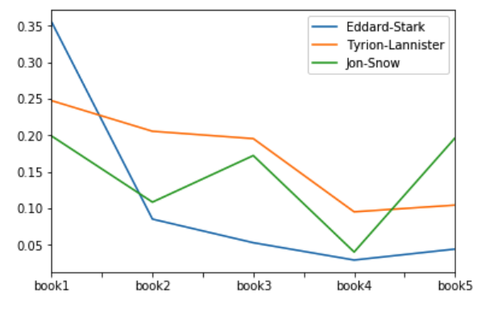
2
2
Result Analysis
Data Analysis
1. Read Data
Over 5 books ...
A suddenly drop for Eddard-Strak!
2. Build Graph
19
延时符

Slide 20
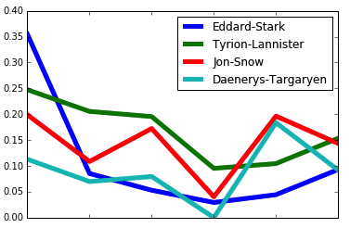
2
2
Result Analysis
Data Analysis
1. Read Data
Over 5 books ...
John-Snow & Daenerys-Targaryen
different physical position , but share similar development trajectory
2. Build Graph
20
延时符

Slide 21
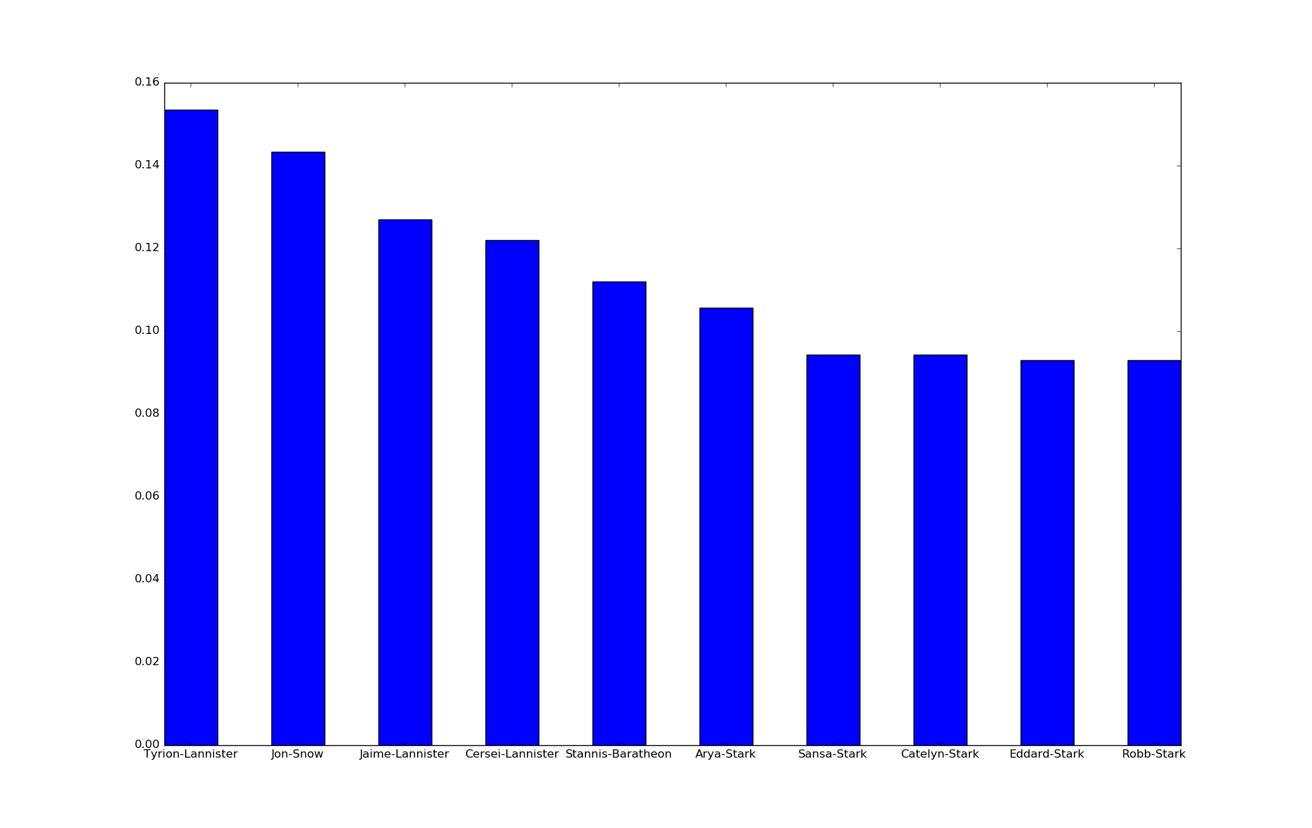
2
2
Result Analysis
Data Analysis
1. Read Data
Over 5 books ...
Betweenness Centrality top 10
Degree Centrality top 10
2. Build Graph
21
延时符

Slide 22
2
2
Result Analysis
Data Analysis
1. Read Data
Over 5 books ...
Betweenness Centrality top 10
Degree Centrality top 10
2. Build Graph
22
延时符

Slide 23
2
Result Analysis
Betweenness Centrality top 10
Jon-Snow
Tyrion-Lannister’,
Daenerys-Targaryen', Theon-Greyjoy’
Stannis-Baratheon
Jaime-Lannister
Cersei-Lannister
Arya-Stark
Eddard-Stark
Robert-Baratheon
Degree Centrality top 10
Tyrion-Lannister
Jon-Snow
Jaime-Lannister
Cersei-Lannister
Stannis-Baratheon
Arya-Stark
Sansa-Stark
Catelyn-Stark
Eddard-Stark
Robb-Stark
Closeness Centrality top 10
Tyrion-Lannister
Robert-Baratheon
Eddard-Stark
Cersei-Lannister
Jaime-Lannister
Jon-Snow
Stannis-Baratheon
Robb-Stark
Joffrey-Baratheon
Catelyn-Stark
延时符

Slide 24
Progress
1
Data Preprocessing
2
Data Analysis
3
Building models
4
Conclusion
延时符

Slide 25
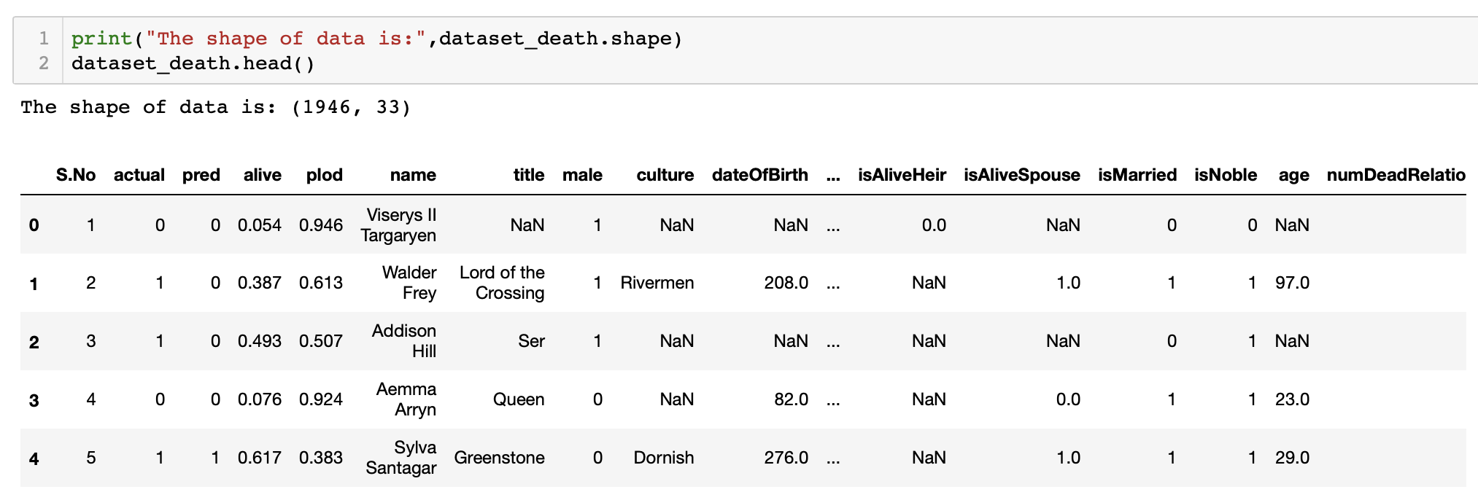
3
Raw Data Set
The data on the death of the character obtained from Kaggle has a total of 1946 rows and 33 columns. These data contain the name, gender, place of residence, kinship, title and other information of the character.
延时符

Slide 26
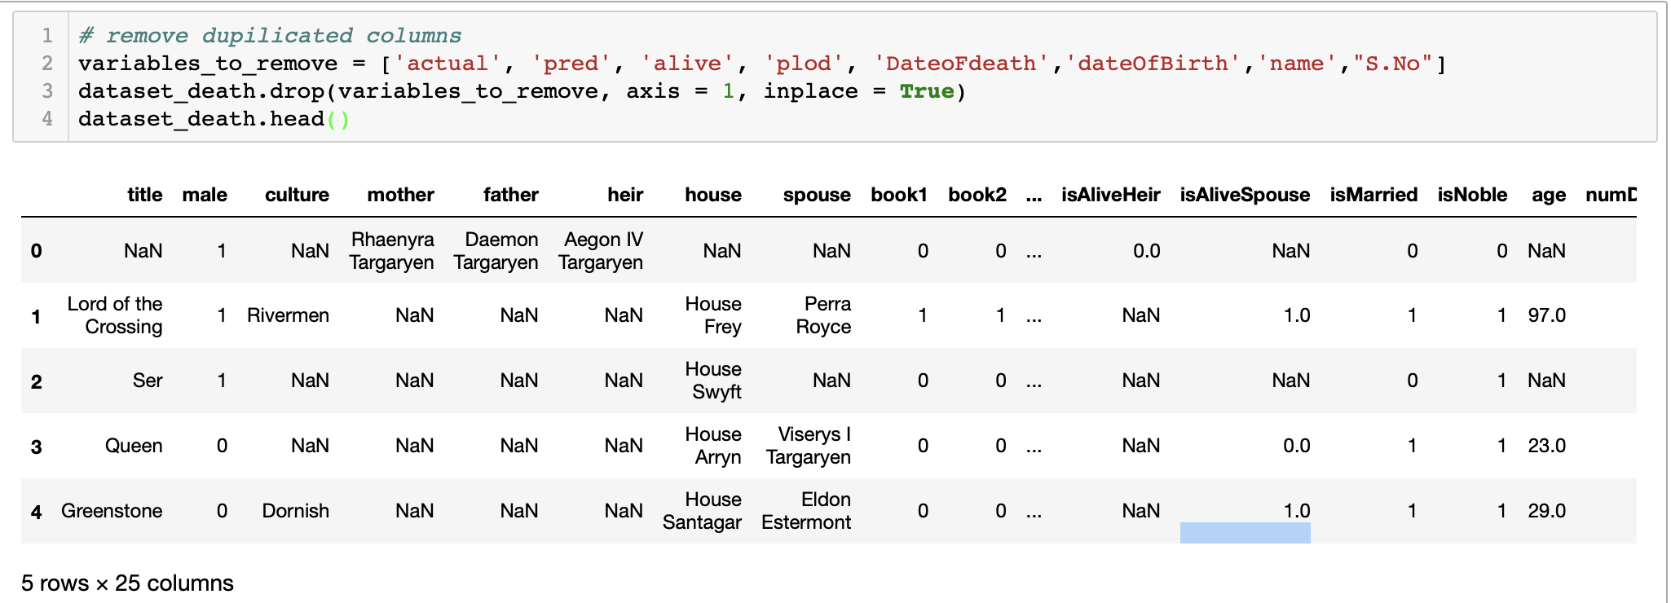
3
Remove Duplicated Columns
There are some duplicated columns and meaningless columns according to the above introduction. such as 'actual', 'pred', 'alive', 'plod', 'DateoFdeath', 'dateOfBirth', ‘name' and "S.No". after deleting, 25 columns are retained.
延时符

Slide 27
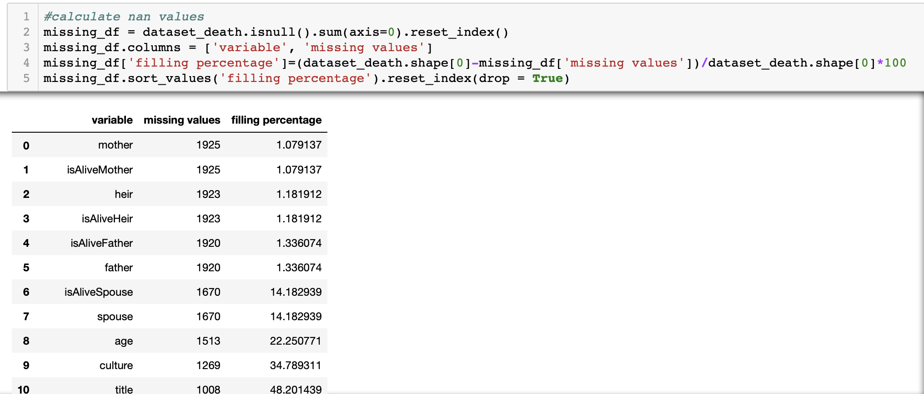
3
Calculate NAN Values
The second step is to see the integrity of the data. First, get the number of nan values in each column, then subtract the number of nan values from the total number of rows, divide the difference by the number of rows, and get the fill rate. Finally, sort the fill rate from small to large. The result shown in the figure below is obtained. So we can select the features that do not reach 100% for missing value processing.
延时符

Slide 28
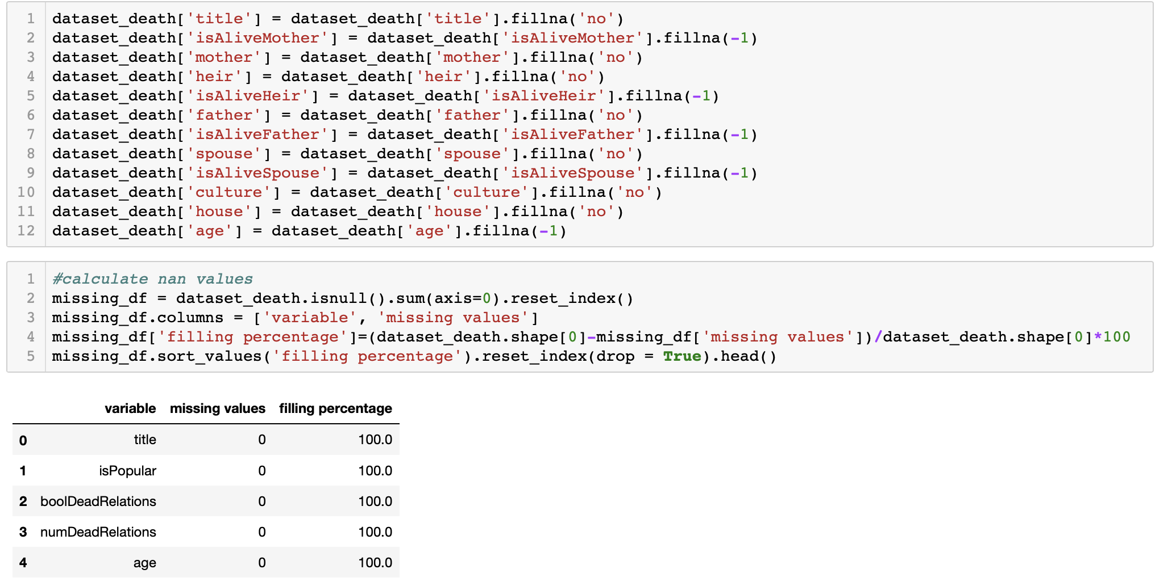
3
Handling the Missing Values
From the analysis in the previous step, we can see that the fill rate of some features is very low, we need to specify the value to fill. According to the data type of each column of data, we use different data types to fill. After the filling is completed, the fill rate of all features is 100%.
延时符

Slide 29
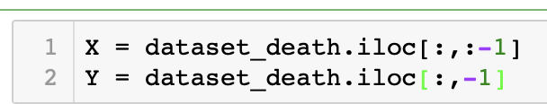
3
Split X And Y
The purpose of our modeling is to predict whether the characters in the novel will die. Therefore, the actual survival state of the character in the novel is Y, and the other factor is X.
延时符

Slide 30
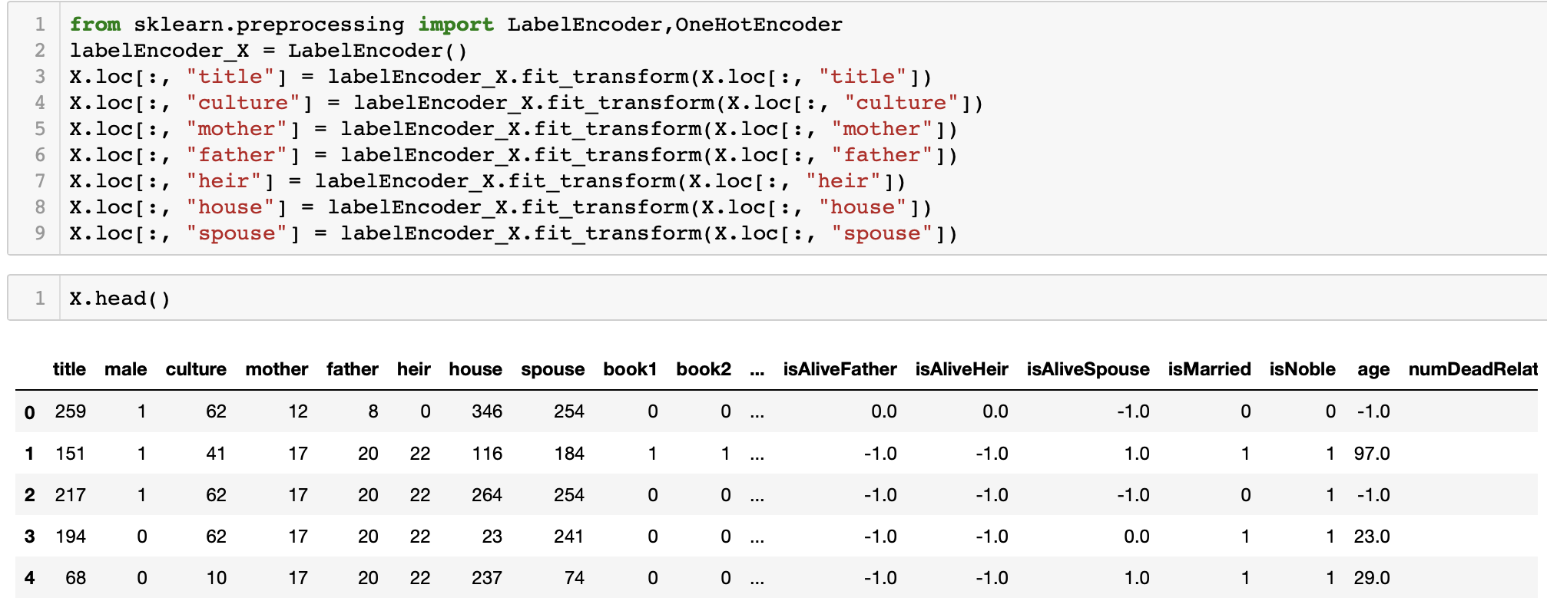
3
Category Data
As previously analyzed, each column of data has a different type. If the type of the data is string, it will affect modeling. Therefore, in this step, data is to be categorized. In this place we use the LabelEncoder. The results after category are shown in the figure below.
延时符

Slide 31
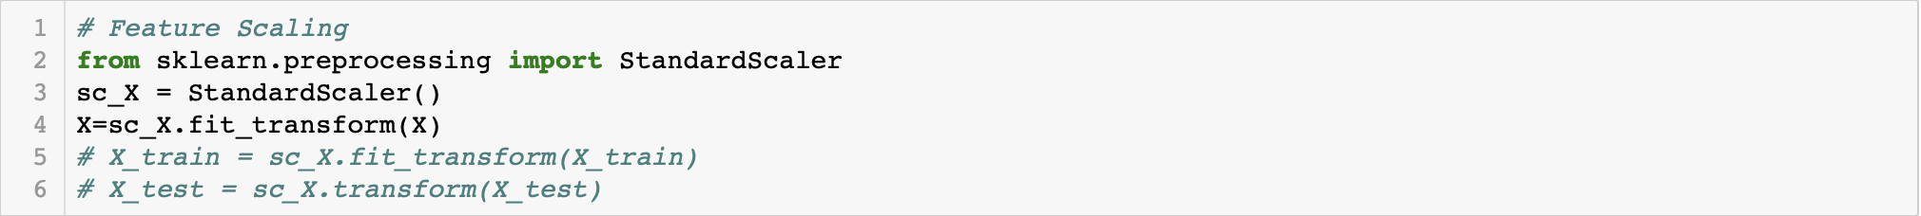
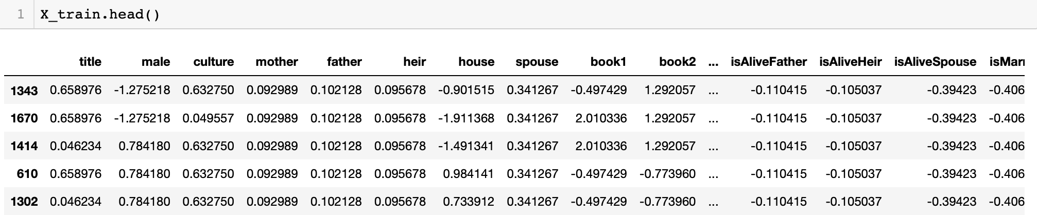
3
Feature Scaling
As can be seen from the data after category, the values of different features vary greatly. Some features have values ranging are from 0-300, and some feature values range are from 0-1. In order to weaken the influence of the value of the feature on the result, we use the StandardScaler for feature scaling.
延时符

Slide 32
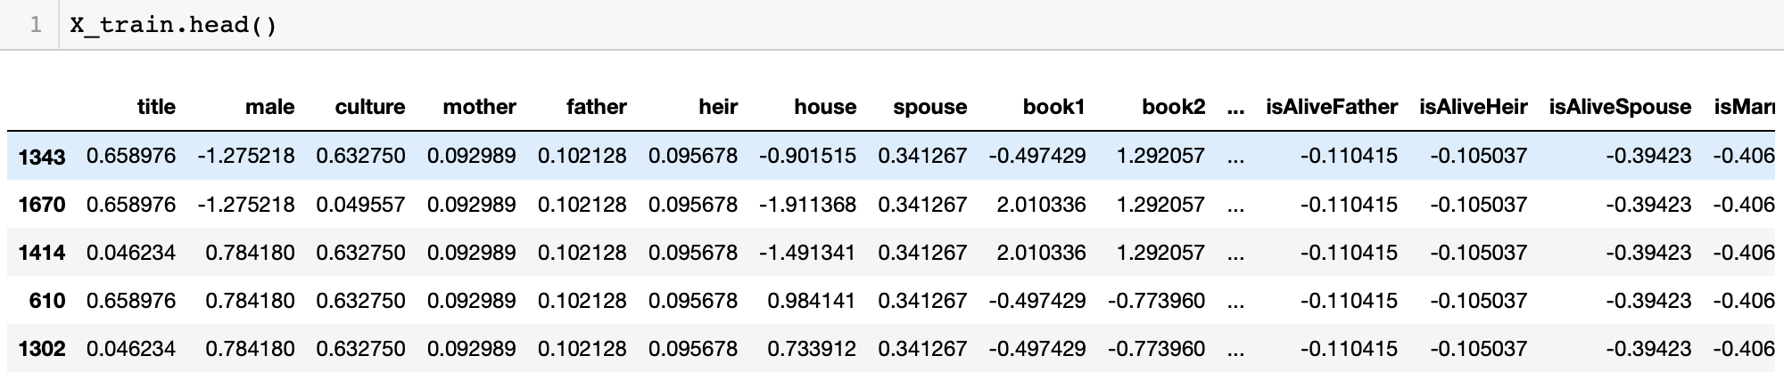
3
Split Training Set and Testing Set
The final step is to divide the training set and test set. With train_test_split, we divide 25% of the data into test sets and 75% of the data into training sets.
延时符

Slide 33
Progress
1
Data Preprocessing
2
Data Analysis
3
Building models
4
Conclusion
延时符

Slide 34
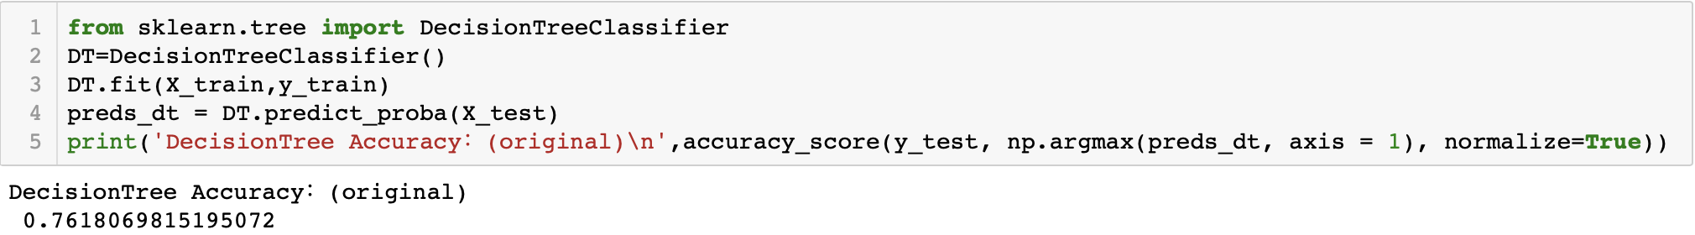
3
Decision Tree Classifier
Basic Model
This is the base model built with the decision tree classifier. In this basic model, we did not specify hyperparameters: there is no limit to the depth and width of the tree, and there is no limit on the number of leaf, and all features are used for prediction. After obtaining the classifier with the training set, the score of the calculated test set is: 0.76. This is not a good score, then we will optimize the model.
延时符

Slide 35
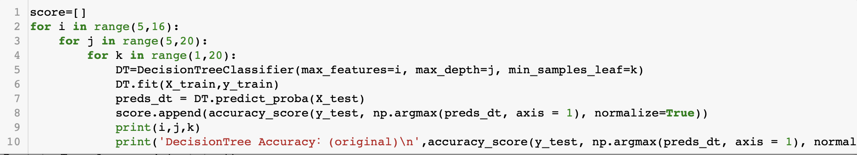
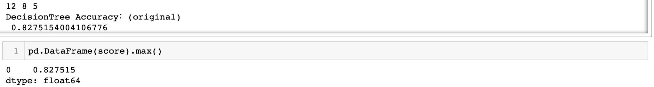
1
Decision Tree Classifier
Optimize Model
In the optimization process, we found that the model scores were improved after specifying the three parameters max_features, max_depth, min_samples_leaf, and the values of other parameters were not positively affected by the results. After three layers of cycles, the model score increased from 0.76 to 0.83. The values of these three features are 12, 8, and 5.
延时符

Slide 36
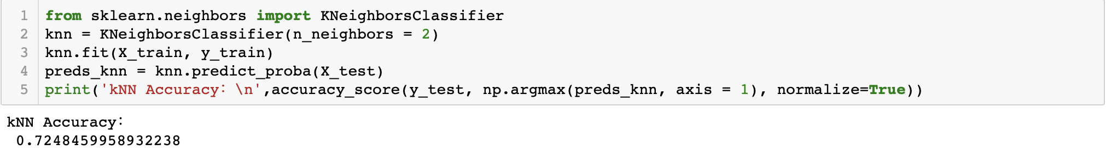
3
K Neighbors Classifier
Basic Model
This is the base model built with the K Neighbors Classifier. In this base model, the number of neighbors, the weight of the neighbor, and the algorithm for calculating the distance is not considered. After obtaining the classifier with the training set, the score of prediction is: 0.72. This is not a good score, then we will optimize the model.
延时符

Slide 37
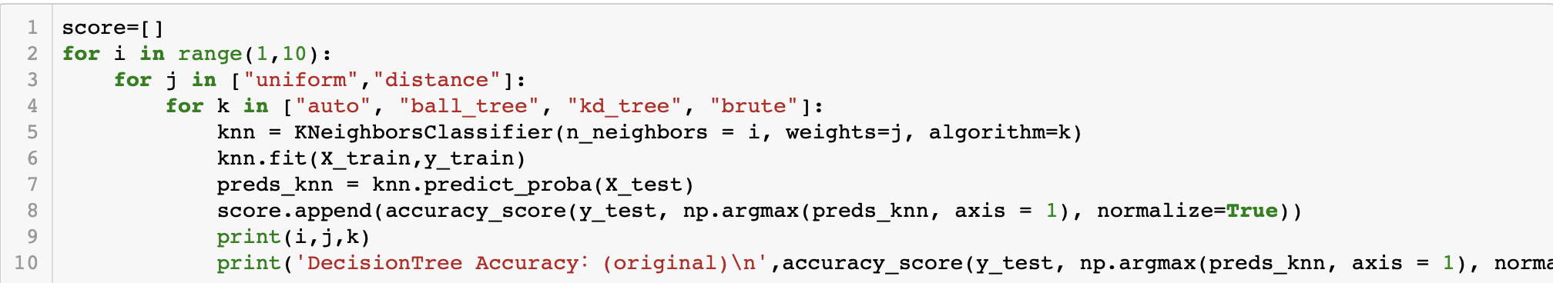
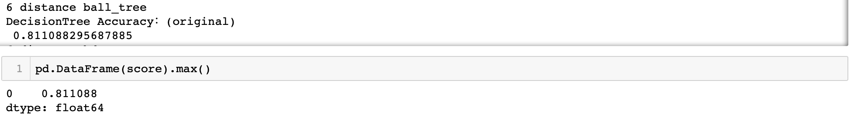
3
K Neighbors Classifier
Optimize Model
In the optimization process, we found that the model scores were improved after specifying the three parameters n_neighbors, weights, and the values of other parameters were not positively affected the results. After three levels of circulation, the model score increased from 0.72 to 0.81. The values of three features are 6, distance and ball tree.
延时符

Slide 38
3
AdaBoostClassifier
Brief Intro
The Adaboost algorithm is a lifting method that combines multiple weak classifiers into a strong classifier.
Its adaptation is that the weights of the samples from the previous weak classifier are enhanced, and the updated samples are used to train the next new weak classifier. In each round of training, the new weak classifier is trained to generate a new sample weight, the voice weight of the weak classifier, and iterate until the predetermined error rate is reached or the specified maximum number of iterations is reached.
Based on the previous model scores, we used the default decision tree and random forest as base_estimator for comparison.
延时符

Slide 39
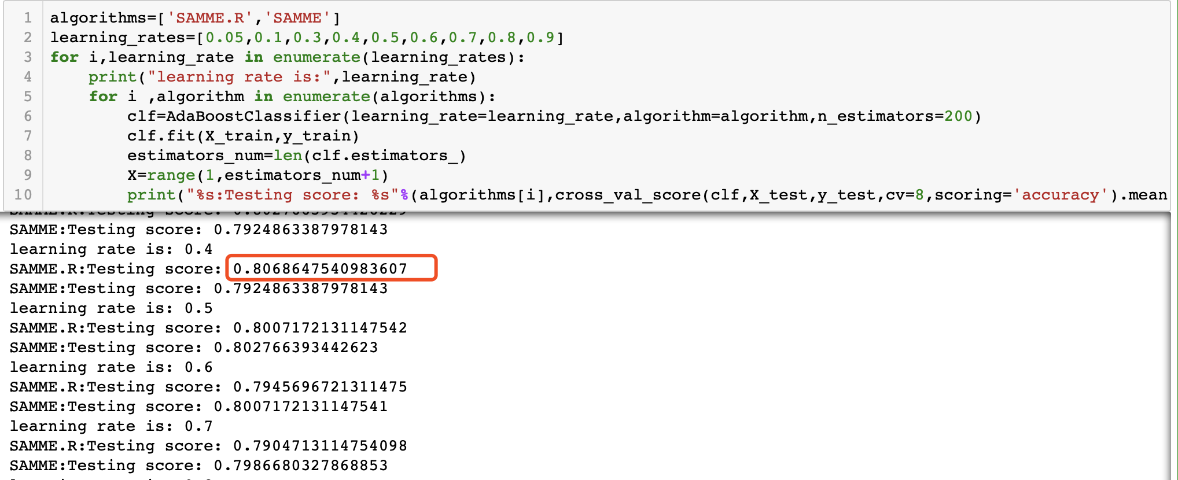
3
AdaBoostClassifier
Decision Tree
This is a decision tree based adaBoostClassifier. In these two layers of loops, we find that the optimal learning rate is 0.4, and the optimal algorithm is SAMME. R. Under the condition of cross-validation, the model's optimal prediction score is 0.81.
延时符

Slide 40
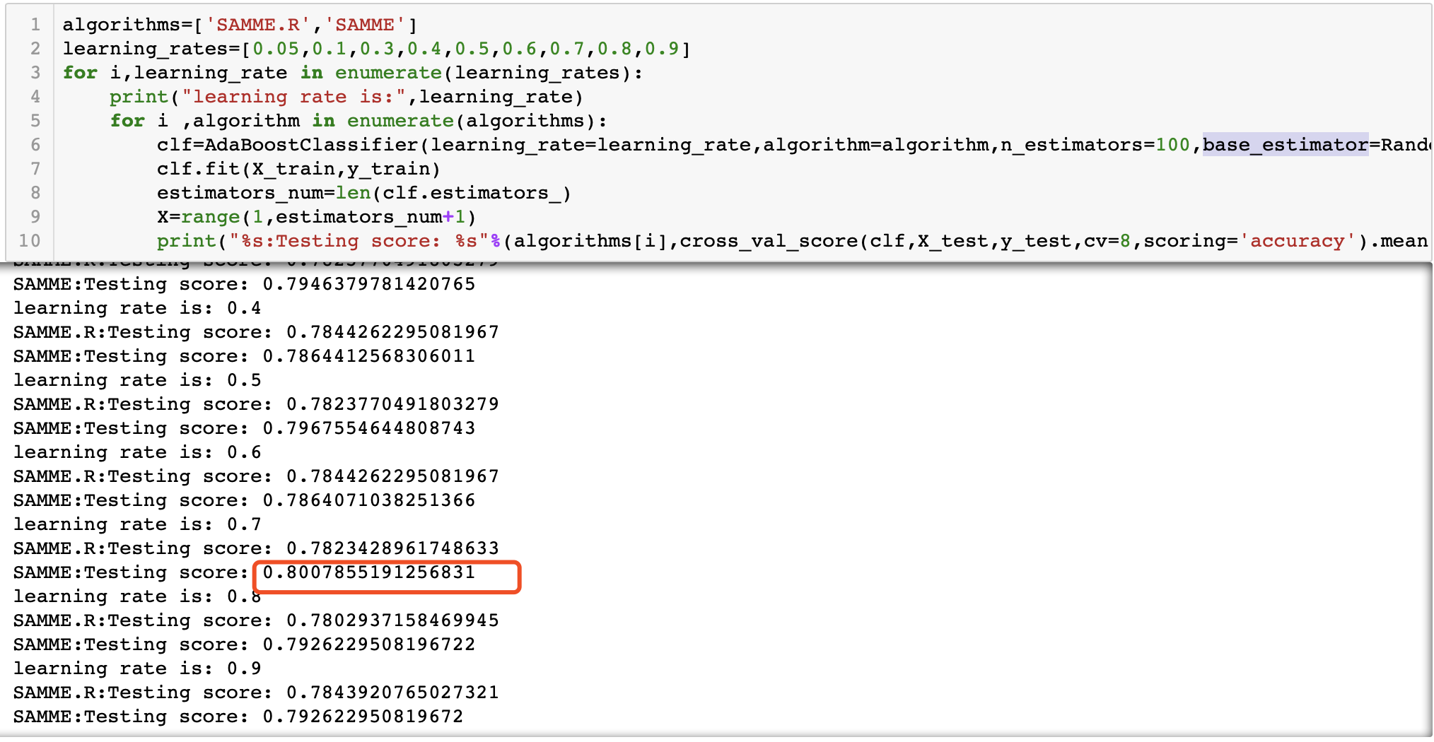
3
AdaBoostClassifier
Random Forest
This is an adaBoostClassifier based on Random Forest. In this step, we still only select the optimal value of the property of AdaBoostClassifier itself. In these two layers of loops, we find that the optimal learning rate is 0.7, and the optimal algorithm is SAMME. Under the condition of cross-validation, the model's optimal prediction score is 0.80.
延时符

Slide 41
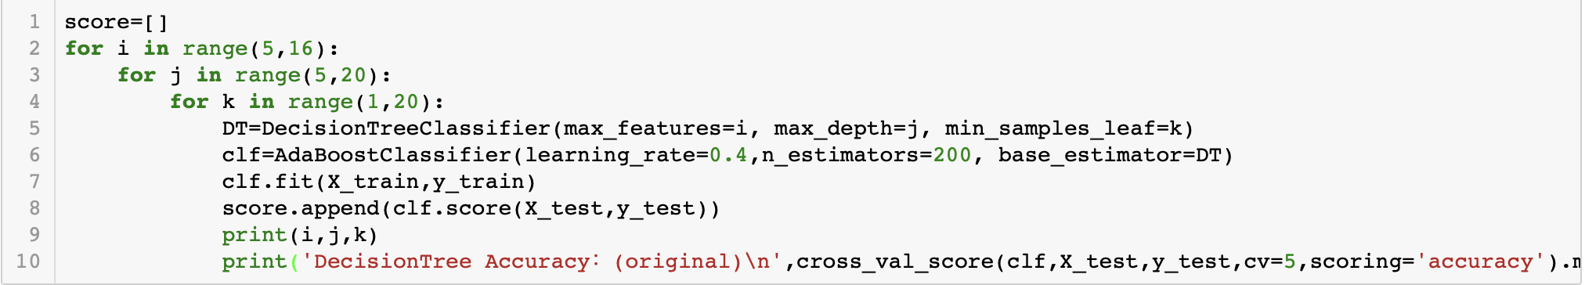
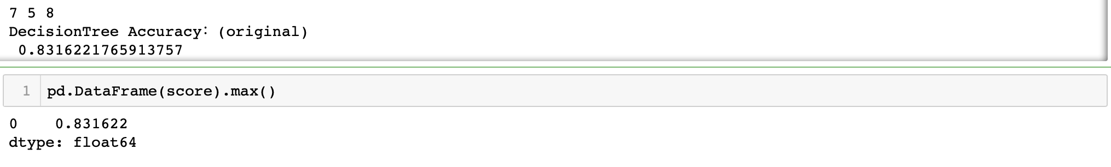
3
AdaBoostClassifier
Optimize Model
In the basic model of the previous step, we can know that the decision tree scores higher than the random forest. So, next we talk about the decision tree as a base esitmaor for optimization. After the optimization process, we select the parameters of the appropriate decision tree. Similar to the iterative process above, we finally found that the model has the highest prediction score when max_features = 7, max_depth = 5 and min_samples_leaf = 8. After this step, our model score increased from 0.8 to 0.83.
延时符

Slide 42
2
3
Linear SVC
Data Analysis
1. Read Data
Definition
SVC means support vector machine.
SVC is a supervised learning method that looks at data and sorts it into one of two categories.
Implement
Import the model: Import SVC, LinearSVC from sklearn.svm
Instantiate an object: Define the classifier by setting the parameter probability=True
Fit the data: Call the fit( ) function to fit the model using the training set data. Use training set data to predict if a character is dead
Score the model: The model is scored using the accuracy_score function that comes with the SVC object. The score can indicate the accuracy of the model prediction.
2. Build Graph
Advantage & Disadvantage
Advantage: Generalization and ease of training
Disadvantage: Over-fitting from optimizing the parameters to model selection
42
延时符

Slide 43
2
3
Naïve Bayes
Data Analysis
1. Read Data
Definition
In machine learning, Naive Bayes classifiers are a family of simple “probabilistic classifiers” based on applying Bayes’ theorem with string (naive) independence assumption between the feature..
Implement
Import the model: from sklearn.naive_bayes import GaussianNB
Instantiate an object: Instantiate the Gaussian NB object.
Fit the data: Call the fit() function to fit the model using the training set data
Predict results: Use the built model to predict result using X_test.
Score the model: The model is scored using the score function..
2. Build Graph
43
延时符

Slide 44
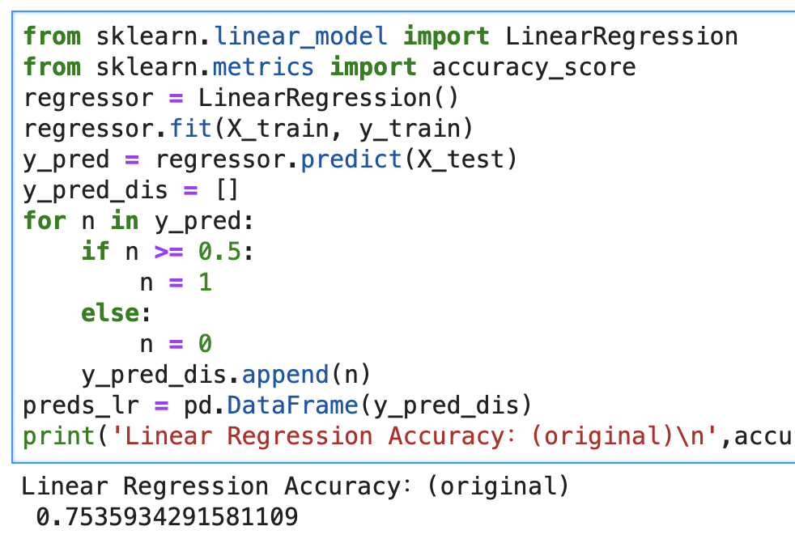
3
Linear Regression
Implementation
Import Model & Instantiate Objects
Fit the Data & Predict Result
Score the Model
延时符

Slide 45
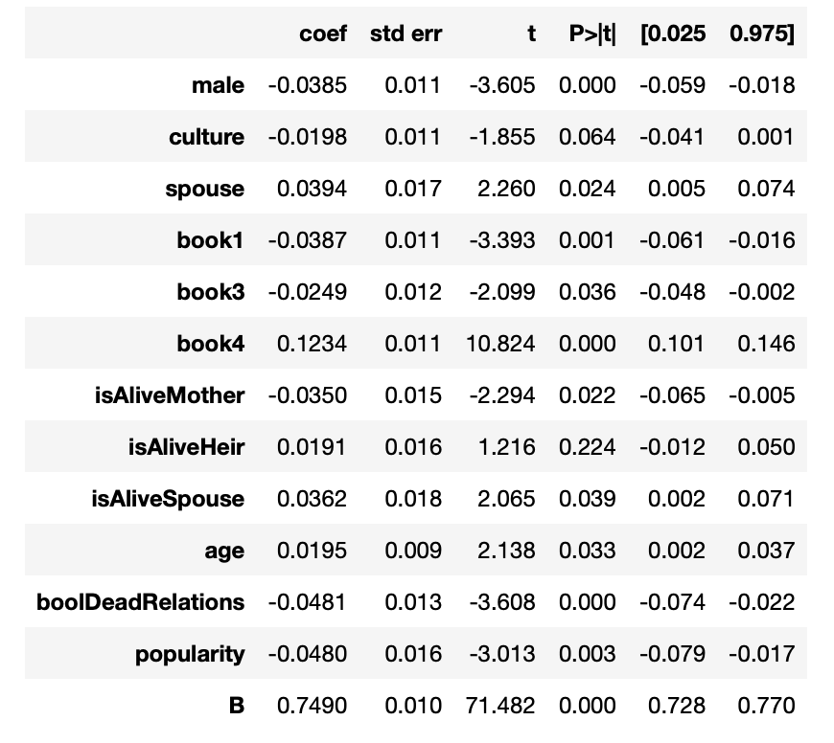
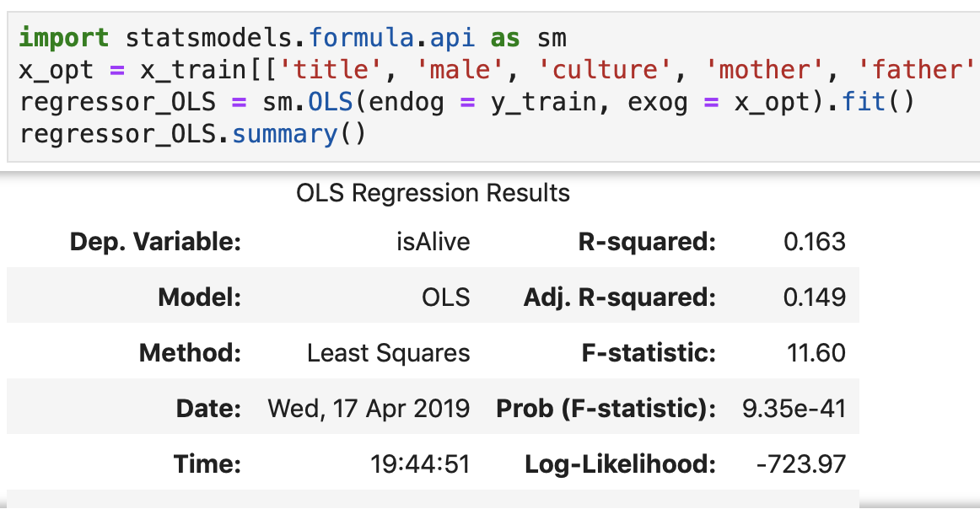
3
Linear Regression
Import Model & Instantiate Objects
Improvement
Fit the Data & Predict Result
Score the Model
延时符

Slide 46
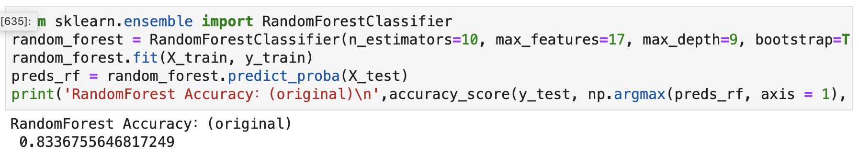
3
Random Forest
Implementation
Score the Model
n_estimator
bootstrap
Fit the Data & Predict Result
max_features
oob_score
max_depth
Score the Model
延时符

Slide 47
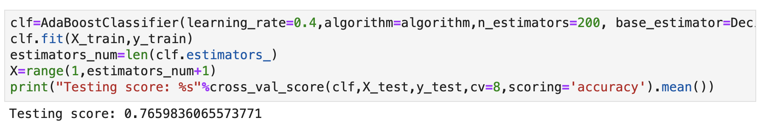
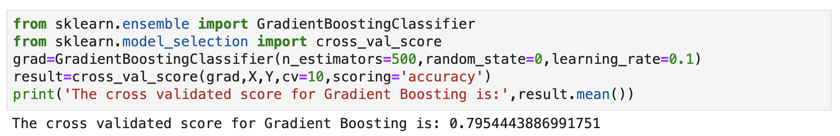
3
Gradient Boosting
Implementation
Cross
Validation
延时符

Slide 48
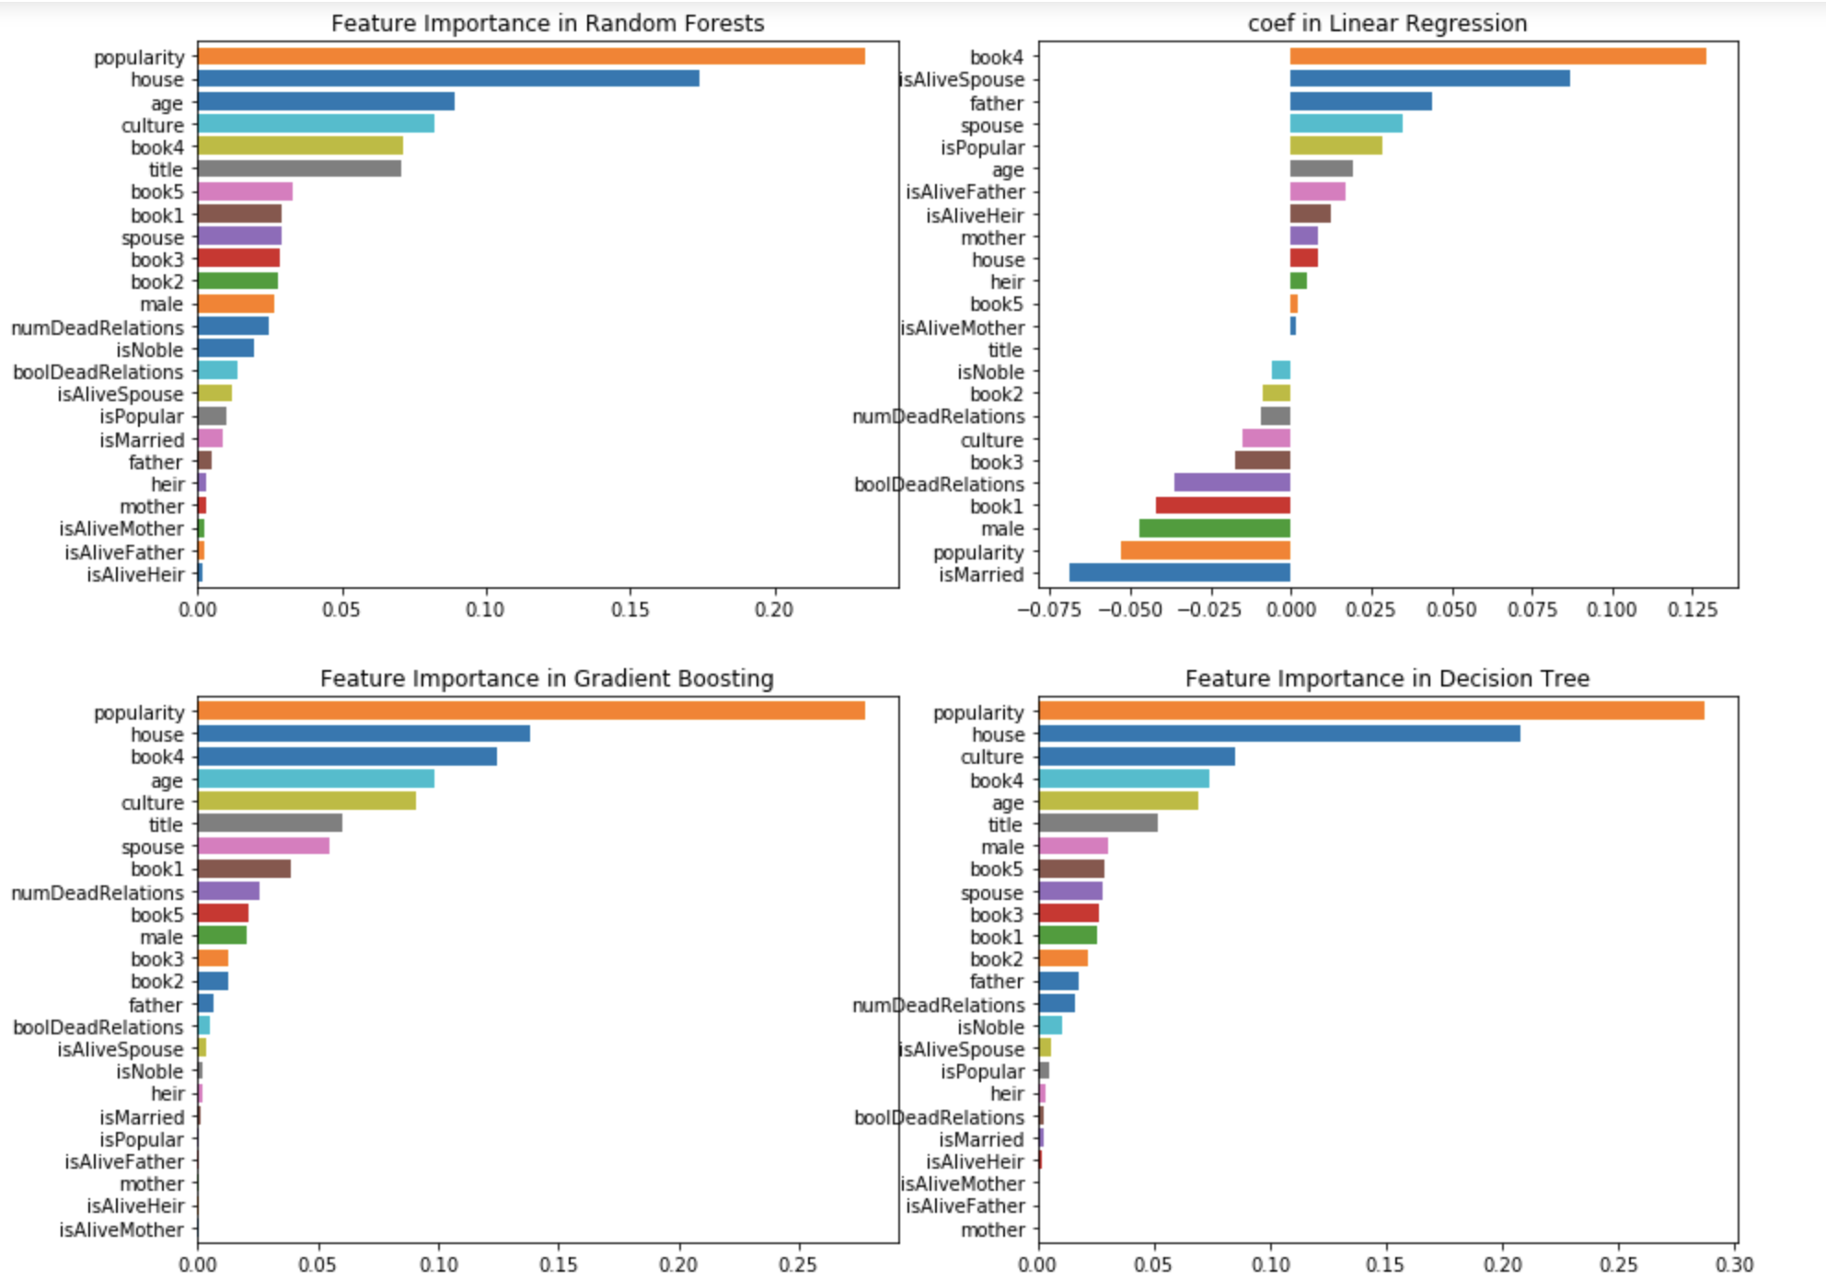
3
Model Analysis and Comparison
This figure shows the importance of each feature in the Random Forest, Decision Tree, and Gradient Boosting algorithms under the current data set, as well as the coefficients of the Linear Regression model.
By observing the following figure, we can see that among the four models, popularity, house and book4 are the three most important factors affecting the results. This conclusion is very easy to understand. For popularity, the author as a novelist is bound to pay attention to the reader's feedback on the characters. If a role is more popular to readers, then he should live longer. For the house, as we said earlier, the background of the "Song of Ice and Fire" story is the kingdom hegemony. When the white walker invade, wars and conflicts will cause more people to die. For the house, it stores information about the place where the character lives. The location of the characters is closely related to their situation and the security, so the house attribute will also greatly affect if the character is survive. For book4, the plot is full of conflicts, and the country is full of battles. Therefore, it is very easy to understand that there are a large number of characters died in this book.
延时符

Slide 49

3
Model Analysis and Comparison
This one shows the confusion matrix drawn by the model constructed by Linear Regression, Random Forest, Decision Tree, Knn, SVC and Naive Bayes algorithm. By showing a picture of the confusion matrix, we can see that each model can divide most of the test sets into the correct category. Among them, Random Forest performed best, and Naive Bayes and Linear Regression performed the worst. The reason may be that linear regression is more suitable for classification problems of continuous distribution. Naive Bayes is more suitable for models such as word bag analysis because of its principle of calculation by matching probability.
For the wrong set, it is mainly because the model divides a part of the role that should have died to be alive. This is also a feature of this novel: there are individual characters who will die unexpectedly. But the survival of most characters is still regular….
延时符

Slide 50

3
Model Analysis and Comparison
This is a ROC plot drawn from six models. The ROC curve is based on a series of different two-class classifications, with TPR as the ordinate and FPR as the abscissa. The ROC observation model correctly identifies the trade-off between the proportion of the positive case and the ratio at which the model incorrectly identifies the negative case data as a positive example. The area under the ROC curve is a measure of the accuracy of the model, AUC (Area under roccurve). According to the definition of ROC, the closer the curve is to the upper left corner, the better the performance of the model. Therefore, linear regression is the worst performer, and random forest performs best. This is consistent with the conclusion we got from the confusion matrix.
延时符

Slide 51
Progress
1
Data Preprocessing
2
Data Analysis
3
Building models
4
Conclusion
延时符

Slide 52
THANKS
延时符

